Slide 1

Topic: Semi-Circles and Quadrants EQ: How do I find the area of semi-circles and quadrants?
circles

Slide 2
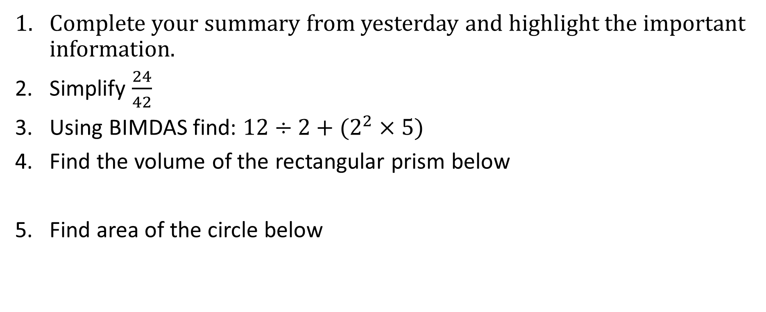
Have a go at these questions:
Topic: Semi-Circles and Quadrants EQ: How do I find the area of semi-circles and quadrants?
Complete your summary from yesterday and highlight the important information.
Simplify $\frac{24}{42}$
Using BIMDAS find: $12÷2+(2^{2}×5)$
Find the volume of the rectangular prism below
Find area of the circle below
6 cm
4 cm
10 cm
5 m

Slide 3
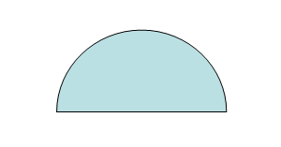
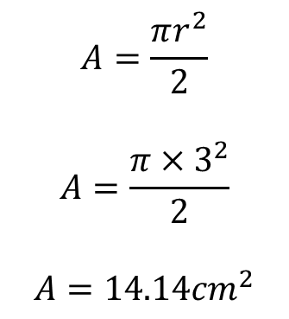
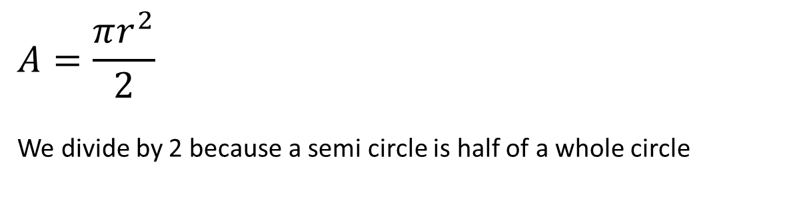
Topic: Circles
EQ: How do I find the area of semi-circles and quadrants?
How do I find the area of semi-circles?
$$A=\frac{πr^{2}}{2}$$
We divide by 2 because a semi circle is half of a whole circle
r
If the radius is 3 cm what is the area of this semi-circle?
$$A=\frac{πr^{2}}{2}$$
$$A=\frac{π{×3}^{2}}{2}$$
$$A=14.14{cm}^{2}$$
3 cm

Slide 4
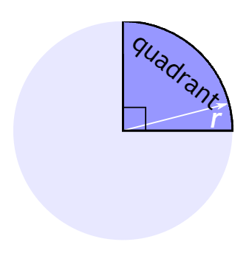
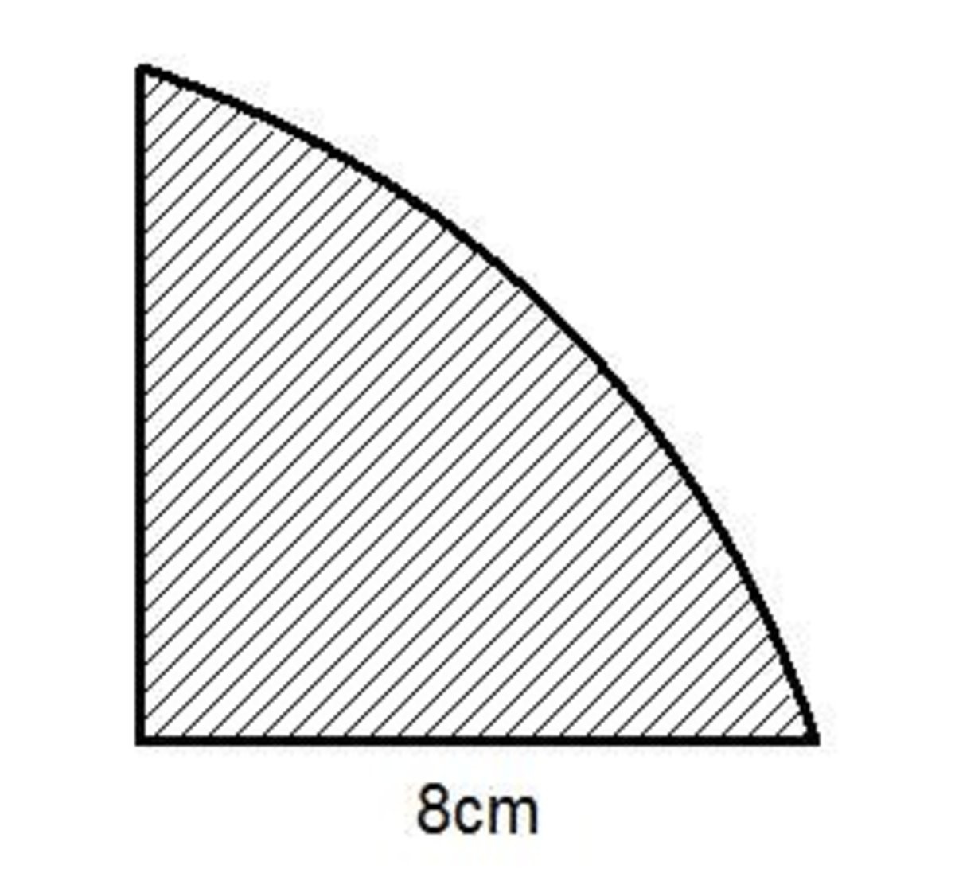
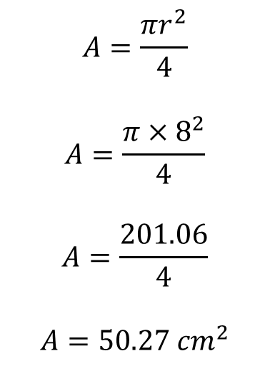
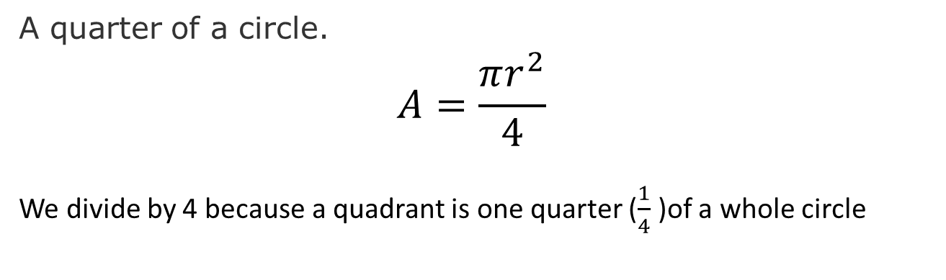
Topic: Circles
EQ: How do I find the area of semi-circles and quadrants?
How do I find the area of a quadrant?
A quarter of a circle.
$$A=\frac{πr^{2}}{4}$$
We divide by 4 because a quadrant is one quarter ($\frac{1}{4}$ )of a whole circle
If the radius is 8 cm what is the area of this quadrant?
$$A=\frac{πr^{2}}{4}$$
$$A=\frac{π{×8}^{2}}{4}$$
$$A=\frac{201.06}{4}$$
$$A=50.27 {cm}^{2}$$

Slide 5
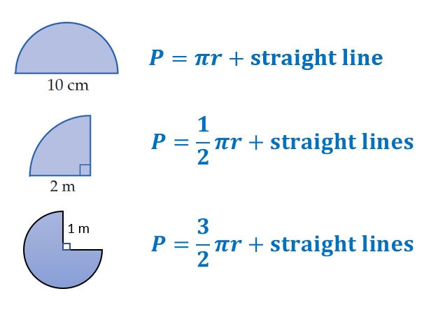
Topic: Circles
EQ: How do I find the area of semi-circles and quadrants?
How do I solve perimeter problems?
* If you have a circle with a diameter you will need to half it in order to find the radius.

Slide 6


Slide 7
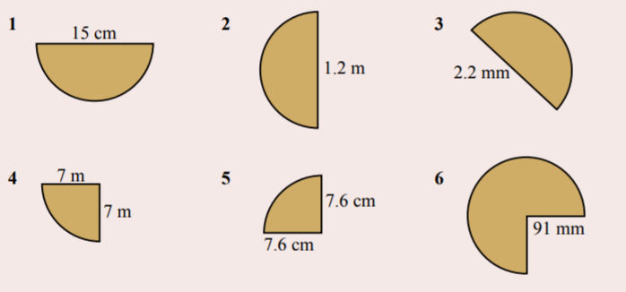
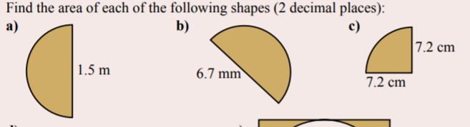
Find the area and perimeter of the following:

Slide 8
What Questions
do you have??

